Slide 1






An Exponential Improvement on the Memorization Capacity of Deep Threshold Networks
Shashank Rajput
UW - Madison
Kartik Sreenivasan
UW - Madison
Dimitris Papailiopoulos
UW - Madison
Amin Karbasi
Yale University

Slide 2

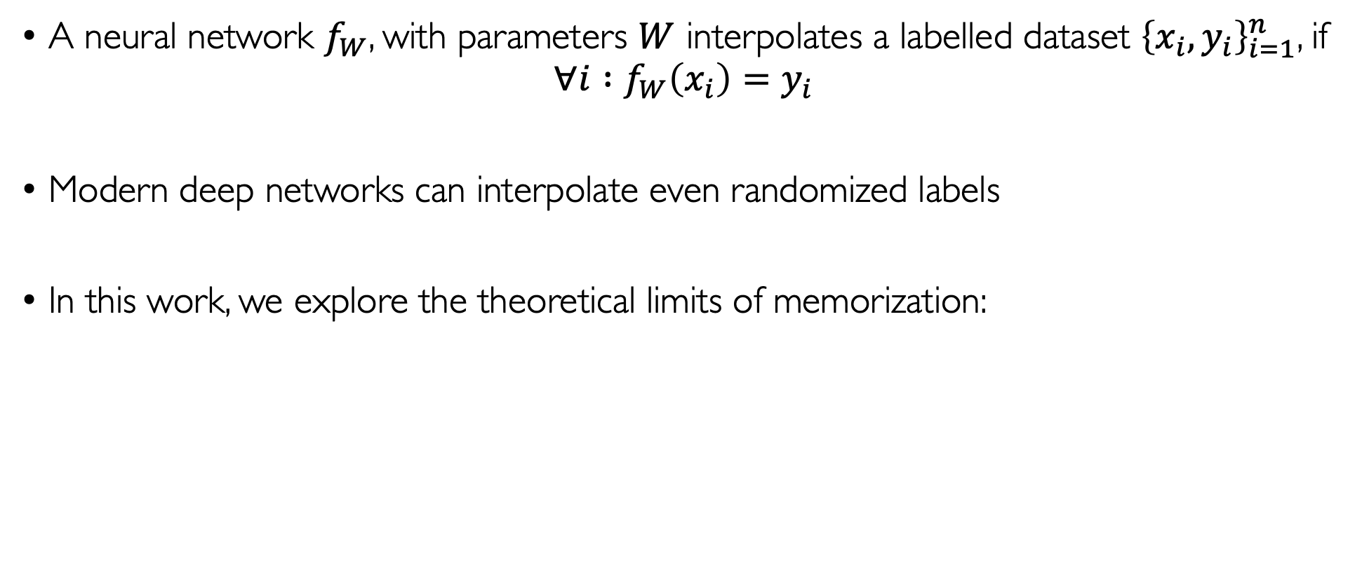
Memorization
A neural network $f_{W}$, with parameters $W$ interpolates a labelled dataset ${\left\{x_{i}, y_{i}\right\}}_{i=1}^{n}$, if
$$∀i :f_{W}\left(x_{i}\right)=y_{i}$$
Modern deep networks can interpolate even randomized labels
In this work, we explore the theoretical limits of memorization:
Def: A neural network memorizes a dataset ${\left\{x_{i}\right\}}_{i=1}^{n}$, if for any set of labels ${\left\{y_{i}\right\}}_{i=1}^{n}$, there exists a $W$ such that $f_{W}$ interpolates ${\left\{x_{i},y_{i}\right\}}_{i=1}^{n}$

Slide 3
Existing Research
Memorization has been studied since the 60s (Cover ‘65)
Early works focused on perceptrons, or threshold activated networks (Baum ‘88)
Recent works have focused on ReLU networks (Zhang et al. ‘17, Park et al. ‘20)
Recent works also connect memorization with generalization (Bubeck ‘21)

Slide 4
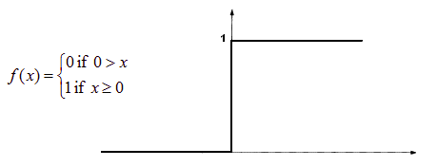
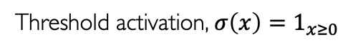
Network architechture
Neurons have threshold activation (Multilayer perceptron)
Threshold activation, $σ\left(x\right)=1_{x≥0}$
Output
Input
How big does the network need to be for memorization?

Slide 5
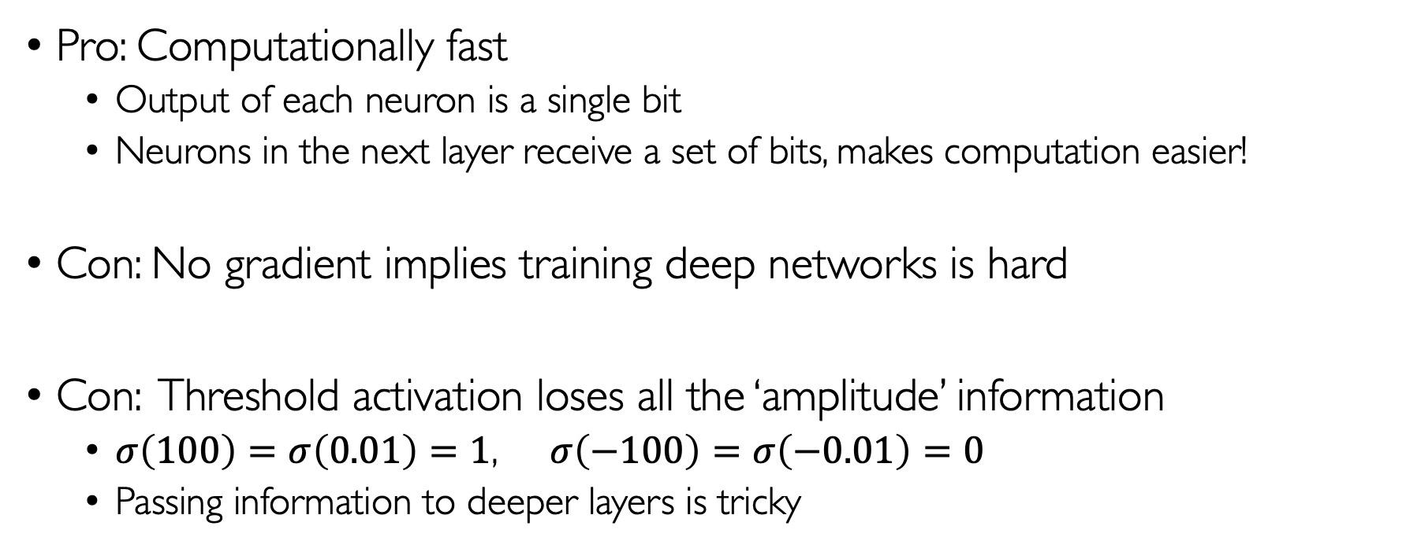
Threshold networks
Pro: Computationally fast
Output of each neuron is a single bit
Neurons in the next layer receive a set of bits, makes computation easier!
Con: No gradient implies training deep networks is hard
Con: Threshold activation loses all the ‘amplitude’ information
$σ\left(100\right)=σ\left(0.01\right)=1$, $σ\left(−100\right)=σ\left(−0.01\right)=0$
Passing information to deeper layers is tricky
Is going deeper beneficial for threshold networks? (Baum, 1988)
Yes! (Vershynin, 2020)
Notes:
Output of each neuron is a single bit. Hence, the neurons in the next layer will receive bits as inputs, which can make the computation for those neurons faster.

Slide 6
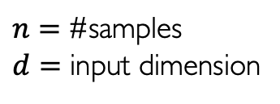
Our results
$n=$ #samples
$d=$ input dimension

Slide 7
Our results
$n=$ #samples
$d=$ input dimension
 | #weights | #neurons | Assumptions
Baum (1988) | $$O(n+d)$$ | $$O(\left\lceil n/d\right\rceil )$$ | Samples are in general position
Notes:
Baum used single hidden layer network

Slide 8
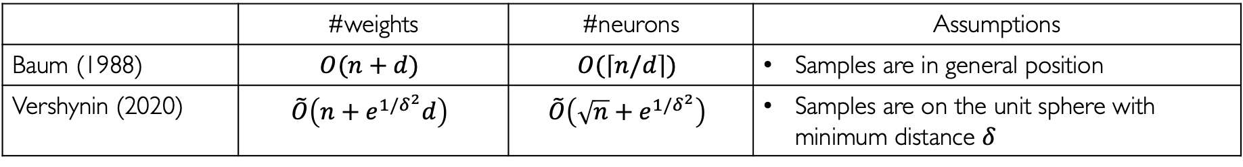
Our results
$n=$ #samples
$d=$ input dimension
 | #weights | #neurons | Assumptions
Baum (1988) | $$O(n+d)$$ | $$O(\left\lceil n/d\right\rceil )$$ | Samples are in general position
Vershynin (2020) | $$\tilde{O}\left({n+e}^{1/δ^{2}}d\right)$$ | $$\tilde{O}\left(\sqrt{n}+e^{1/δ^{2}}\right)$$ | Samples are on the unit sphere with minimum distance $δ$
Notes:
Vershynin used a deep network

Slide 9
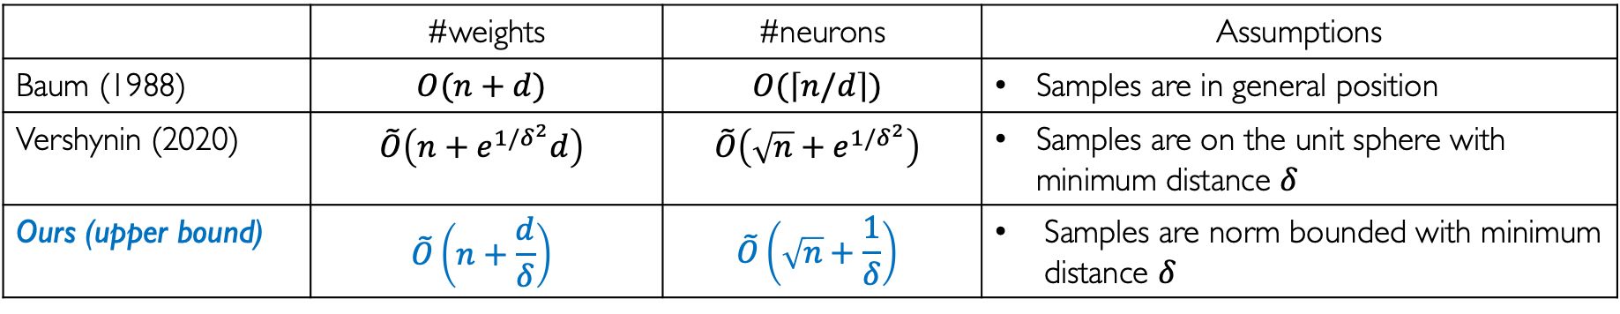
Our results
$n=$ #samples
$d=$ input dimension
 | #weights | #neurons | Assumptions
Baum (1988) | $$O(n+d)$$ | $$O(\left\lceil n/d\right\rceil )$$ | Samples are in general position
Vershynin (2020) | $$\tilde{O}\left({n+e}^{1/δ^{2}}d\right)$$ | $$\tilde{O}\left(\sqrt{n}+e^{1/δ^{2}}\right)$$ | Samples are on the unit sphere with minimum distance $δ$
Ours (upper bound) | $$\tilde{O}\left(n+\frac{d}{δ}\right)$$ | $$\tilde{O}\left(\sqrt{n}+\frac{1}{δ}\right)$$ | Samples are norm bounded with minimum distance $δ$

Slide 10
Our results
$n=$ #samples
$d=$ input dimension
 | #weights | #neurons | Assumptions
Baum (1988) | $$O(n+d)$$ | $$O(\left\lceil n/d\right\rceil )$$ | Samples are in general position
Vershynin (2020) | $$\tilde{O}\left({n+e}^{1/δ^{2}}d\right)$$ | $$\tilde{O}\left(\sqrt{n}+e^{1/δ^{2}}\right)$$ | Samples are on the unit sphere with minimum distance $δ$
Ours (upper bound) | $$\tilde{O}\left(n+\frac{d}{δ}\right)$$ | $$\tilde{O}\left(\sqrt{n}+\frac{1}{δ}\right)$$ | Samples are norm bounded with minimum distance $δ$
Exponential improvement on the dependence on $δ$!

Slide 11
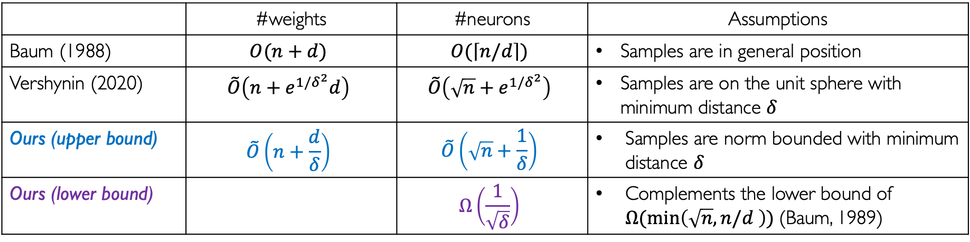
Our results
$n=$ #samples
$d=$ input dimension
 | #weights | #neurons | Assumptions
Baum (1988) | $$O(n+d)$$ | $$O(\left\lceil n/d\right\rceil )$$ | Samples are in general position
Vershynin (2020) | $$\tilde{O}\left({n+e}^{1/δ^{2}}d\right)$$ | $$\tilde{O}\left(\sqrt{n}+e^{1/δ^{2}}\right)$$ | Samples are on the unit sphere with minimum distance $δ$
Ours (upper bound) | $$\tilde{O}\left(n+\frac{d}{δ}\right)$$ | $$\tilde{O}\left(\sqrt{n}+\frac{1}{δ}\right)$$ | Samples are norm bounded with minimum distance $δ$
Ours (lower bound) |  | $$Ω\left(\frac{1}{\sqrt{δ}}\right)$$ | Complements the lower bound of $Ω(\min\left(\sqrt{n},n/d \right))$(Baum, 1989)

Slide 12
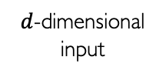
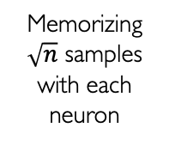
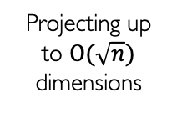
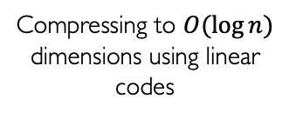
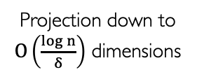
Upper bound
Theorem 1: Given a $δ$-separated dataset, there exists a threshold network with $O\left(\frac{\left(d+\log{n}\right)\log{n}}{δ}+n\log^{2}{n}\right)$ weights and $O\left(\frac{\log^{2}{n}}{δ}+\sqrt{n}\log^{2}{n}\right)$ neurons that can memorize it.
Memorizing $\sqrt{n}$ samples with each neuron
$d$-dimensional
input
Projection down to
$O\left(\frac{\log{n}}{δ}\right)$ dimensions
Compressing to $O(\log{n})$ dimensions using linear codes
Projecting up to $O(\sqrt{n})$ dimensions
Subset partition
Summation
Output
Notes:
Use Gaussian random hyperplanes to project the input down to 𝑂(log⁡𝑛/𝛿) dimensions.
Simulate linear codes to compress 𝑂(log⁡𝑛/𝛿) down to 𝑂(log⁡𝑛 ) dimension binary vector.
Partition the set of 𝑛 samples into √𝑛 subsets of size √𝑛.
Project the vectors to 𝑂(√𝑛) dimensions. It feels counter-intuitive to first compress the input down to log n dimensions and then project up to \sqrt(n) dimensions, but the key requirement that we had was to ensure that that the vectors in each subset were linearly independent, and unfortunately, we were not able to achieve that directly, without first compressing down to log n dimensions. Bypassing this compression led to a worse dependence on delta.
Memorize √𝑛 samples with each neuron. We are able to achieve this exactly because we constructed the \sqrt{n} subsets such that the vectors inside them were linearly independent.

Slide 13
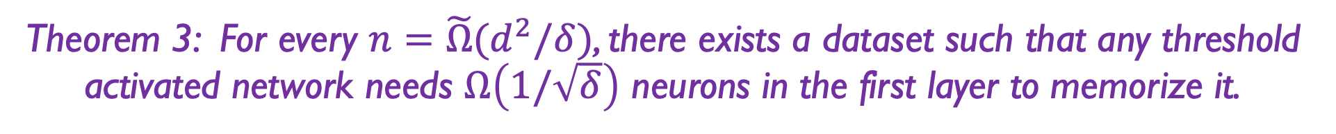
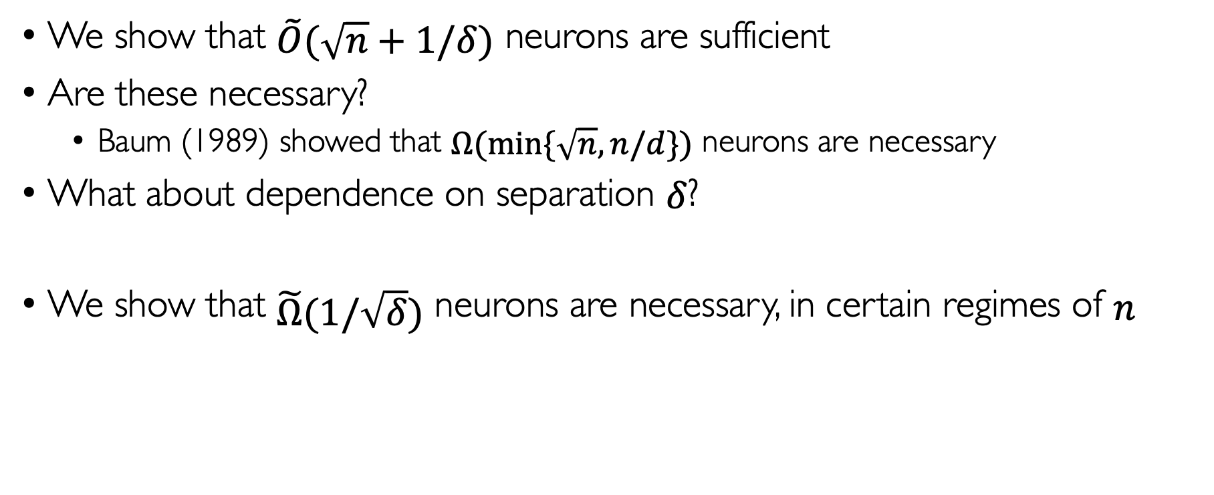
Lower Bound
We show that $\tilde{O}(\sqrt{n}+1/δ)$ neurons are sufficient
Are these necessary?
Baum (1989) showed that $Ω(\min{\{\sqrt{n}, n/d\}})$ neurons are necessary
What about dependence on separation $δ$?
We show that $\tilde{Ω}(1/\sqrt{δ})$ neurons are necessary, in certain regimes of $n$
Theorem 3: For every $n=\tilde{Ω}(d^{2}/δ)$, there exists a dataset such that any threshold activated network needs $Ω\left(1/\sqrt{δ}\right)$ neurons in the first layer to memorize it.

Slide 14
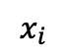

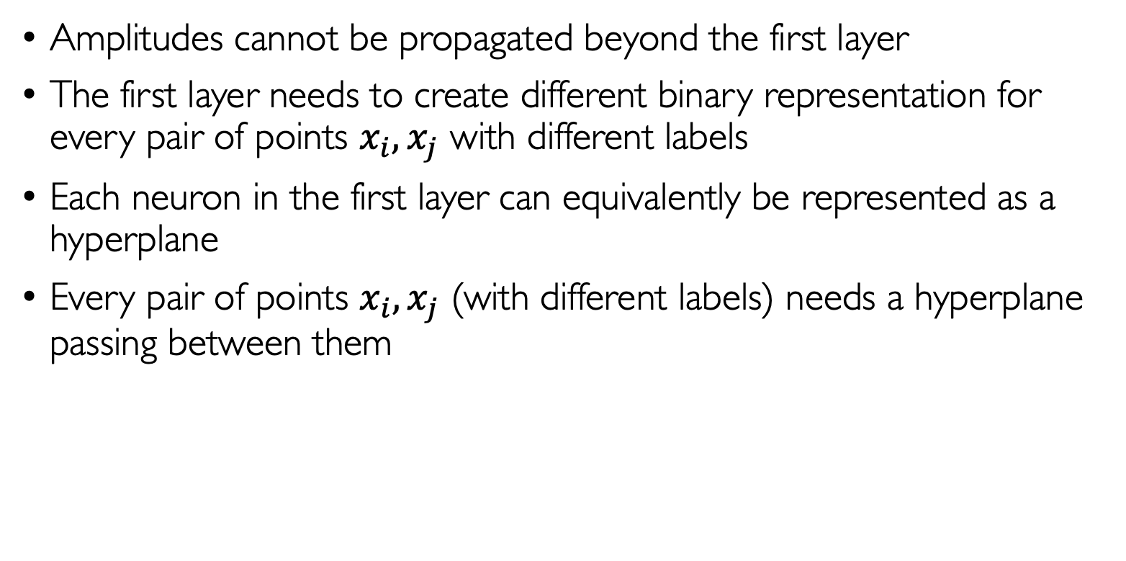
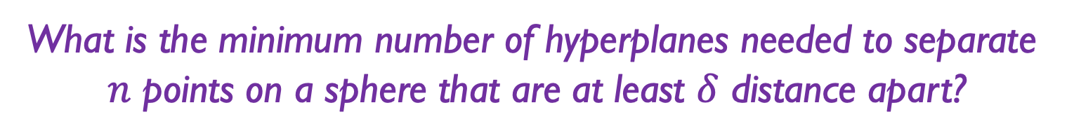
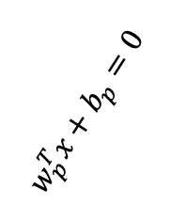
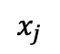
Lower bound idea
Amplitudes cannot be propagated beyond the first layer
The first layer needs to create different binary representation for every pair of points $x_{i},x_{j}$ with different labels
Each neuron in the first layer can equivalently be represented as a hyperplane
Every pair of points $x_{i},x_{j}$ (with different labels) needs a hyperplane passing between them
$$x_{i}$$
$$x_{j}$$
$$w_{p}^{T}x+b_{p}=0$$
What is the minimum number of hyperplanes needed to separate
$n$ points on a sphere that are at least $δ$ distance apart?
Answer: $Ω\left(\frac{\log{n}}{\sqrt{δ}} \right)$ hyperplanes are needed

Slide 15
Experiments
We ran our memorization algorithm on MNIST
We see some generalization
We can train deep threshold networks without SGD
Interestingly, if we naïvely increase our network capacity, then overfitting hurts generalization.
We believe at the correct capacity, our network starts behaving like nearest neighbor classifier.
of first layer

Slide 16
References
Thomas M Cover. Geometrical and statistical properties of systems of linear inequalities with applications in pattern recognition. 1965.
Eric B Baum. On the capabilities of multilayer perceptrons. 1988.
Chiyuan Zhang, Samy Bengio, Moritz Hardt, Benjamin Recht, and Oriol Vinyals. Understanding deep learning requires rethinking generalization. 2017.
Sejun Park, Jaeho Lee, Chulhee Yun, and Jinwoo Shin. Provable memorization via deep neural networks using sub-linear parameters. 2020.
Sébastien Bubeck, Yuanzhi Li, and Dheeraj M. Nagaraj. A law of robustness for two-layers neural networks. 2021.
Roman Vershynin. Memory capacity of neural networks with threshold and rectified linear unit activations. 2020.
Eric B Baum. What size net gives valid generalization. 1989.
Thank you!

